Slide 1

EC551 Advanced Digital Design with Verilog and FPGA (Fall 2022)
Team: Fried Chips
Chathura Rajapaksha
Farhan Tanvir Khan
Farbin Fayza
December 6, 2022

Slide 2
Goal, Short Specification & Functionality
Goal:
Implement a fun game with FPGA
Game Components:
Character
Moves up & down
Shoots
Balloons
Spawn randomly
Rise upwards
Bombs
Spawn randomly
Fall downwards
Farhan
Score ++
Surprise!!

Slide 3
Goal, Short Specification & Functionality
Game Rules
60 seconds time limit
Shooting balloons increments the score
Shooting bombs = !!!
Farhan
Score ++
Surprise!!

Slide 4
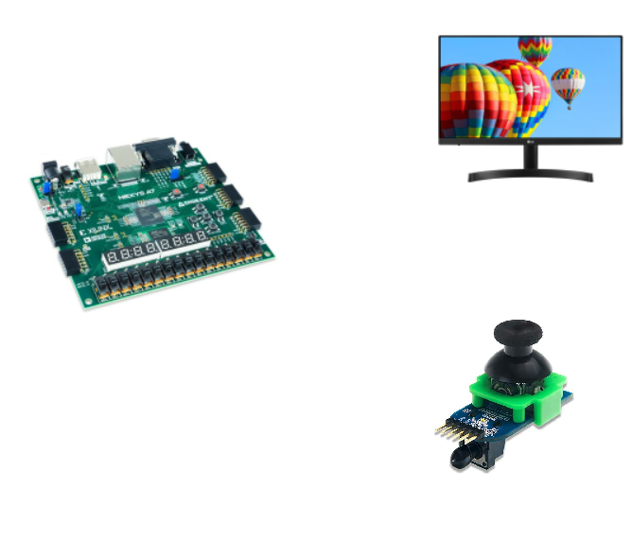
Goal, Short Specification & Functionality
Game Control
Monitor for display
Joystick for game control
Y-axis up and down
Button to shoot
Optionally, Nexys A7 onboard buttons for game control
Helped us to work together at the same time
Monitor
Nexys A7 Board
Joystick
Notes:
Optionally, Nexys A7 onboard buttons can be used for game control (you can play the game even without a joystick!)
Potentially add or mention above point

Slide 5
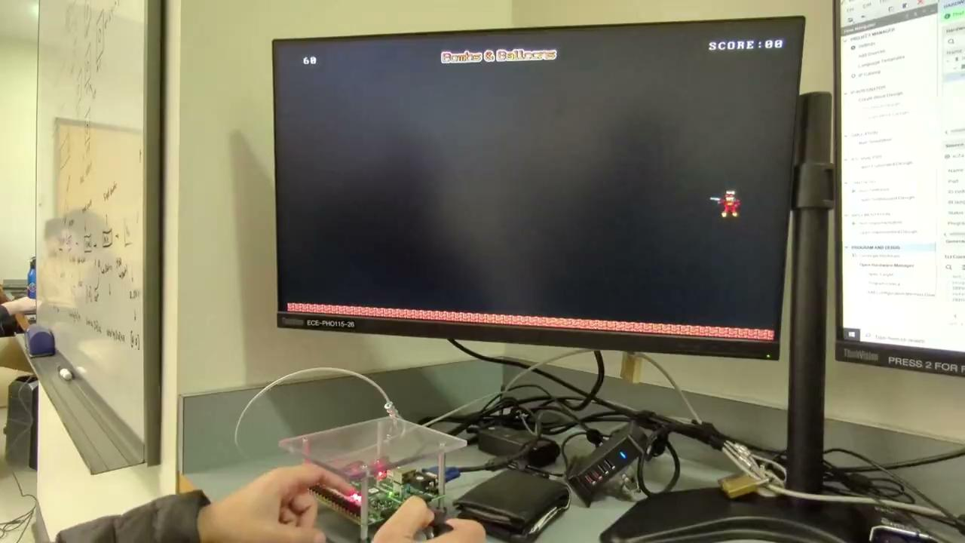
Demo for Detailed Functionality
Video: 60 Seconds Plain Game

Slide 6
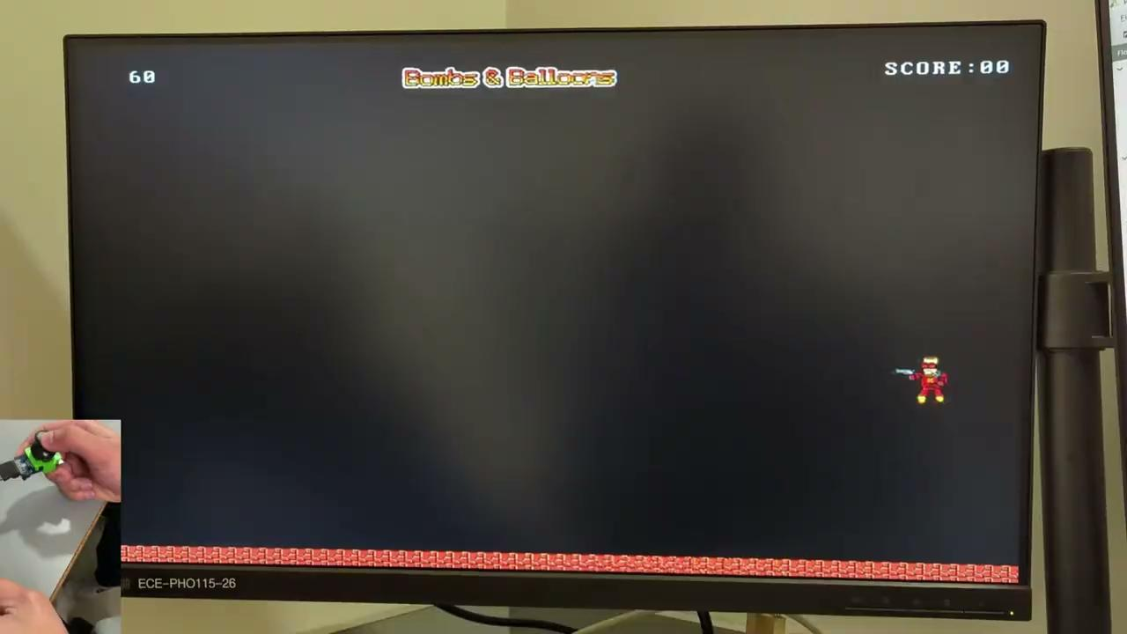
Demo for Detailed Functionality
Video: The Bombs!

Slide 7
Detailed Block Diagram
Balloon Module
Balloon Module
Balloon Module
Balloon Module
Character
(40x44) x 2
Balloon
(18x24) x 4
Bomb
(16x24) x 2
Brick
(70x50)
Title
(150x22)
Game Over
(150x22)
BOOM!
(50x50)
Fonts
Joystick/FPGA Push Buttons
Random Number Generator Module
(LFSR)
N
Up/Down
Shoot
Balloon positions
Top Module
BRAM Module
Image RGB values
VGA Module
Character y position
Shoot signal
VGA
output
Monitor
(Display handler)
VGA output
Bomb positions
(Controller)
Balloon Module
Balloon Module
Balloon Module
Bomb Module
Random Number Generator Module
(LFSR)
BRAM
M
Notes:
This is the previous one, need to update

Slide 8
Detailed Block Diagram Showing Individual Contribution
Balloon Module
Balloon Module
Balloon Module
Balloon Module
Character
(40x44) x 2
Balloon
(18x24) x 4
Bomb
(16x24) x 2
Brick
(70x50)
Title
(150x22)
Game Over
(150x22)
BOOM!
(50x50)
Fonts
Joystick/FPGA Push Buttons
Random Number Generator Module
(LFSR)
N
Up/Down
Shoot
Balloon positions
Top Module
BRAM Module
Image RGB values
VGA Module
Character y position
Shoot signal
VGA
output
Monitor
(Display handler)
VGA output
Bomb positions
(Controller)
Balloon Module
Balloon Module
Balloon Module
Bomb Module
Chathura
Random Number Generator Module
(LFSR)
Farhan
BRAM
M
Farbin
Notes:
This is the previous one, need to update

Slide 9
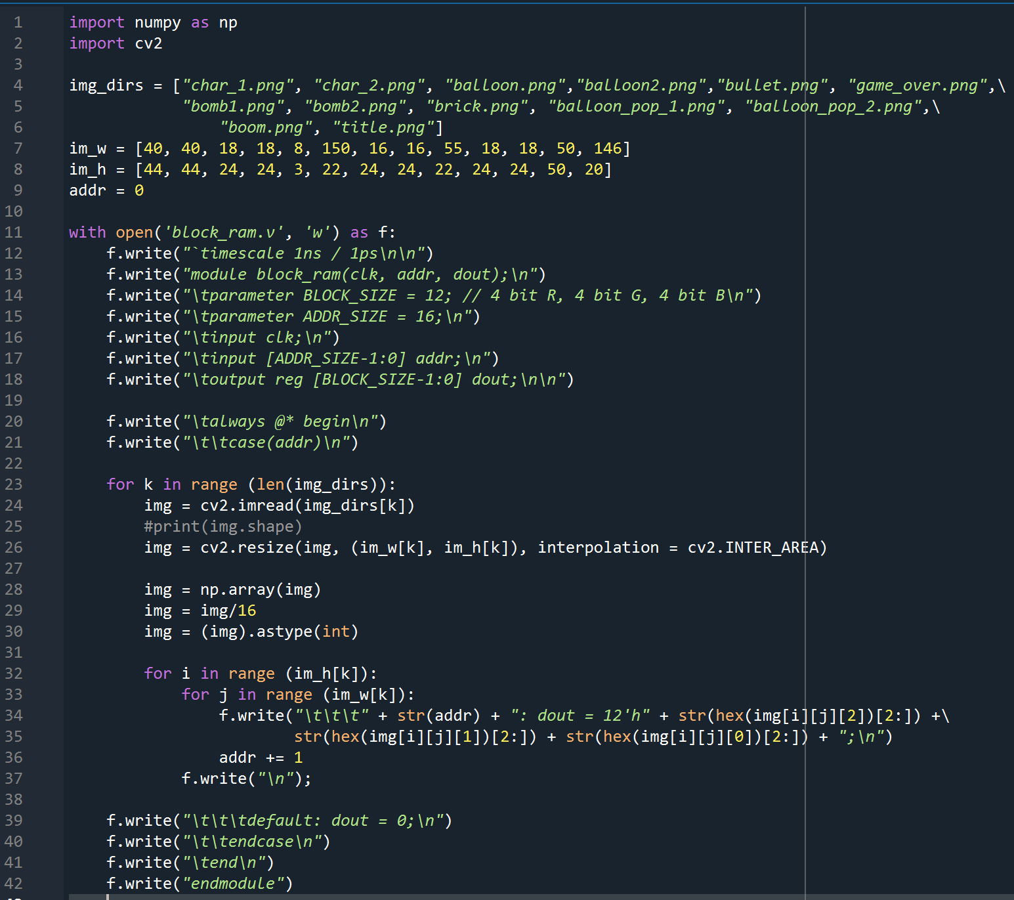
BRAM Module
BRAM module generated with a python script
Specify the image locations, desired widths and heights
Print the initial codes in verilog module
Resize the image
Scale the RGB values to fit in 4 bits (Here, max pixel value = 256)
Print the pixel address and the RGB values in hex digits
Print the ending verilog codes
pixel_converter.py
bombs-n-balloons/sprites_bram_generator/pixel_converter.py

Slide 10
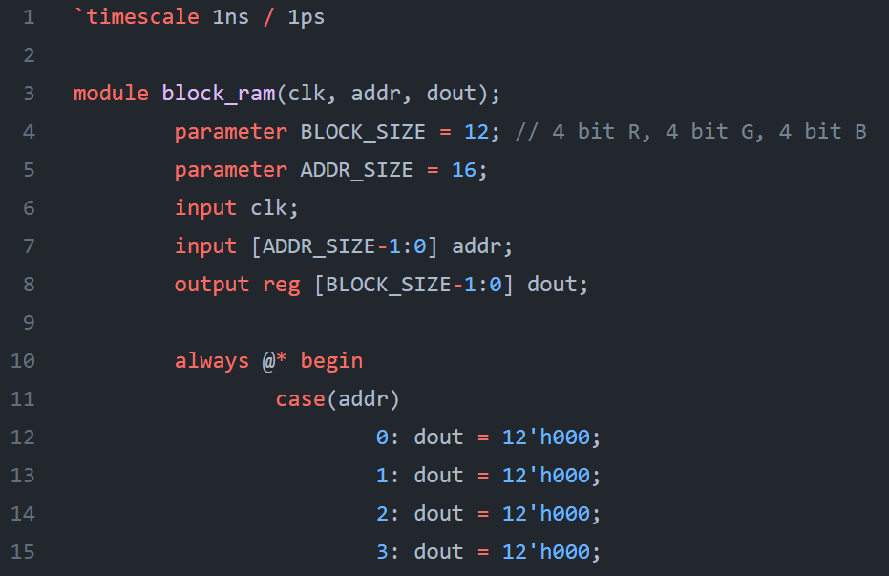
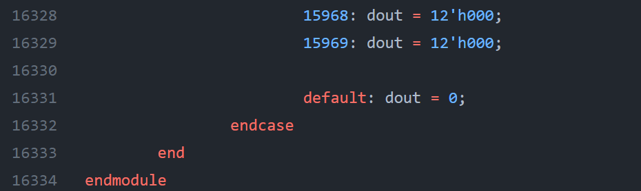
BRAM Module
BRAM module generated with a python script
…
pixel_converter.py
block_ram.v
Notes:
This is the previous one, need to update

Slide 11
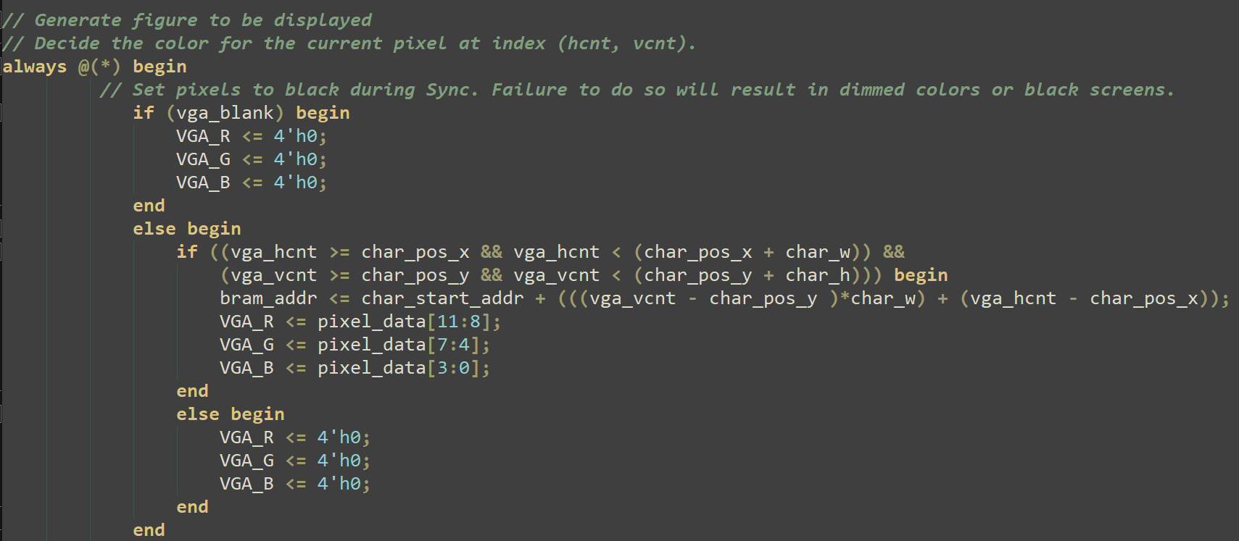
VGA Module
Draws all the sprites and displays texts
How to draw?
Iterate through all the pixels
See if the pixel position corresponds to a sprite position
Read the color of the pixel from the BRAM
Set VGA R, G, B outputs accordingly
Refresh the screen (always set to black)
Check if the sprite (character) needs to be drawn in the current pixel
Yes? Then calculate the BRAM address for the pixel of that sprite, and read RGB values (the bram module sets the RGB to pixel_data given the bram_addr)
No? Just draw black pixel
An example of drawing an image (character) in vga.v
Sample VGA code was given for our lab assignment 1.
Notes:
This is the previous one, need to update

Slide 12
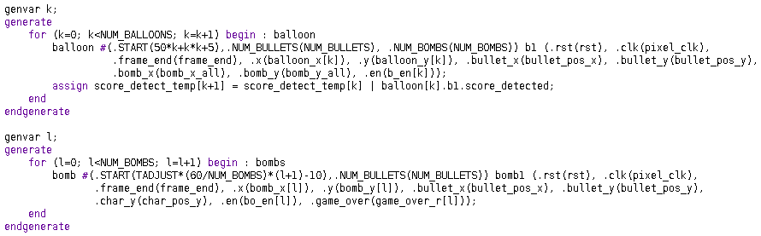
Verilog Example
Generate blocks to make the design scalable
Number of balloons and bombs are parameterized using generate blocks
Notes:
Cross-module references (XMRs) to simplify the code (only for single use debug scenarios)

Slide 13
Verilog Example
Generate blocks to make the design scalable
Number of balloons and bombs are parameterized using generate blocks
Notes:
Cross-module references (XMRs) to simplify the code (only for single use debug scenarios)

Slide 14
Verilog Example
Generate blocks to make the design scalable
Number of balloons and bombs are parameterized using generate blocks
Notes:
Cross-module references (XMRs) to simplify the code (only for single use debug scenarios)

Slide 15
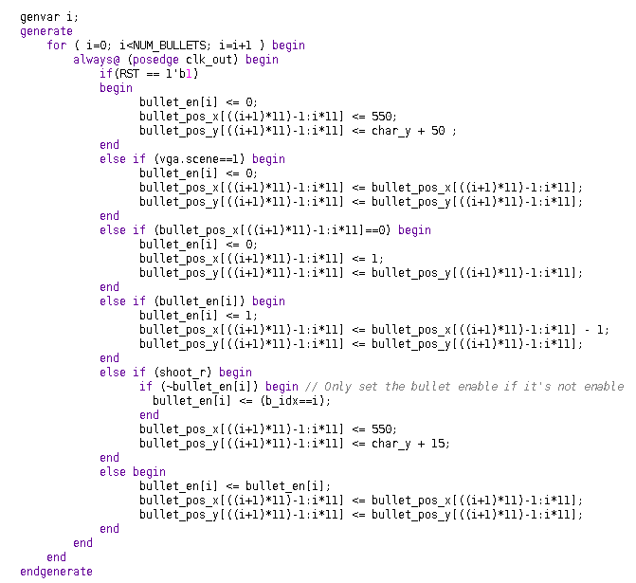
Verilog Example
Generate blocks to make the design scalable
Enabling multiple bullets on the screen at the same time in a scalable manner

Slide 16
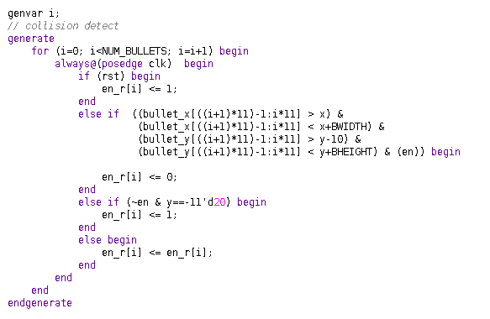
Collision Detection Implementation
(0,0)
X
(x,y)
(bullet_x, bullet_y)
Y
BHEIGHT
BWIDTH
480x640 resolution screen
Collision detection of a balloon with a bullet.
Defined in balloon module in balloon.v file.

Slide 17
Successes
Finished making the game on time
All the functionalities proposed in the project proposal are implemented correctly
Successfully used the sprites
Did not run out of memory (18% utilization)
Multiple use of low resolution sprites
Animation of character, bombs, and balloons
Balloon popping animation
We worked till 1 AM in the lab!
Crazy bomb physics successfully implemented
Hiding the non-transparent background of the sprites
Everything with black background or in rectangular shape
Bombs and balloons barely collide due to their physics
Farhan finally found a title for the game!

Slide 18
Failures & Design Tradeoffs
Could not add music (We are very sorry)
Needed a speaker or converter, ran out of time
Focused more on visual improvement
Little glitches in the sprites at a certain part of the monitor
Solved some position-independent glitching problems by analyzing corner cases
Still some glitches at a certain position, could not figure out why
We wanted more images
Very long synthesis time for more/larger images
Difficult to finish the project with a large BRAM
Added all the inactive sprites at the end

Slide 19

Github link: https://github.com/sammy17/bombs-n-balloons

